Slide 1
Programming paradigms
Created by Ehtiram Shukurov

Slide 2
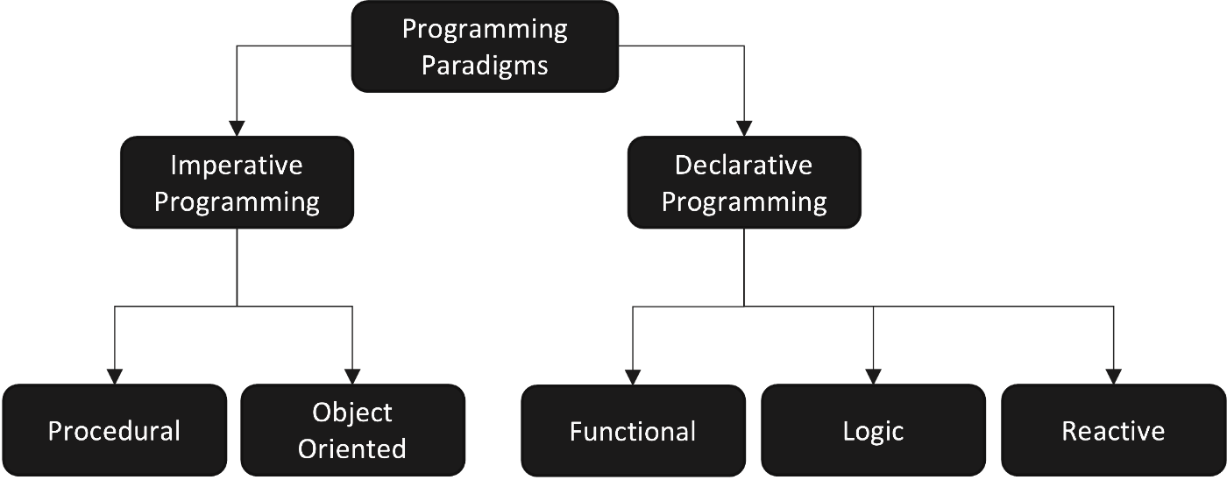
Database
Parallel

Slide 3
Imperative
It's called "imperative" because as programmers we dictate exactly what the computer has to do, in a very specific way.
Imperative programming focuses on describing how a program operates, step by step.
Say you want to bake a cake. Your imperative program to do this might look like this:
1- Pour flour in a bowl
2- Pour a couple eggs in the same bowl
3- Pour some milk in the same bowl
4- Mix the ingredients
5- Pour the mix in a mold
6- Cook for 35 minutes
7- Let chill
int sum = 0;
sum += 1;
sum += 2;
sum += 3;
sum += 4;
printf("The sum is: %d\n", sum);

Slide 4
2. Procedural programming
Procedural programming (which is also imperative) allows splitting those instructions into procedures. Procedures aren't functions. The difference between them is that functions return a value, and procedures do not.
#include <iostream>
using namespace std;
int main()
{
int i, fact = 1, num;
cout << "Enter any Number: ";
cin >> number;
for (i = 1; i <= num; i++) {
fact = fact * i;
}
cout << "Factorial of " << num << " is: " << fact << endl;
}
It's simple.
An easier way to keep track of program flow.
It has the ability to be strongly modular or structured.
Needs less memory: It's efficient and effective.

Slide 5
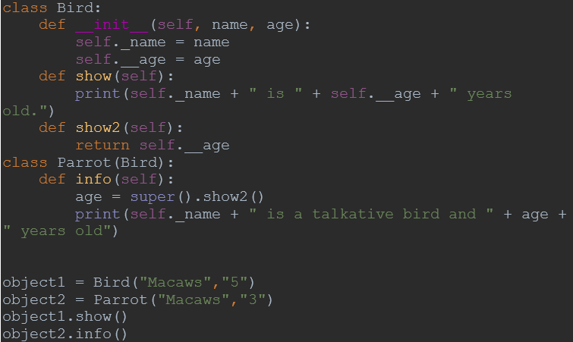
3. Object oriented programming
The key characteristics of object-oriented programming include Class, Abstraction, Encapsulation, Inheritance and Polymorphism. It can handle almost all kind of real life problems which are today in scenario.
Advantages:
Data security
Inheritance
Code reusability
Flexible and abstraction is also present

Slide 6
4.Parallel programming
approach
Parallel processing is the processing of program instructions by dividing them among multiple processors. It allows many processors to run a program in less time by dividing them up.
Advantages and usage
Speeds up performance.
Often used in Artificial Intelligence.
It makes it easy to solve problems since this approach seems to be like a divide and conquer method.
You can use it if you have a system that has more than one CPU or multi-core processors which are commonly found on computers today.

Slide 7
5.Declarative programming
Declarative programming is a style of building programs that focuses on what needs to be achieved instead of instructing how to achieve it.Examples would be HTML, XML, CSS, SQL, Prolog, Haskell, F#and Lisp.
Declarative code focuses on building logic of software without actually describing its flow. You are saying what without adding how. For example with HTML you use <img src="./image.jpg" /> to tell browser to display an image and you don’t care how it does that.

Slide 8
6.Logic programming
The logic programming paradigm isn't made up of instructions - rather it's made up of facts and clauses. It uses everything it knows and tries to come up with the world where all of those facts and clauses are true.
man(Socrates).
mortal(X) :- man(X).
The first line can be read, "Socrates is a man.'' It is a base clause, which represents a simple fact. The second line can be read, "X is mortal if X is a man;'' in other words, "All men are mortal.'' This is a clause, or rule, for determining when its input X is "mortal.''
Logic paradigm is right for you if you're planning to work on projects like theorem proving, expert systems, term rewriting, type systems and automated planning.

Slide 9
7. Functional programming
In this way, we can assure the function doesn't modify anything outside its scope. It only creates a variable to process its own information, and once the execution is finished, the variable is gone too.
const nums = [1,4,3,6,7,8,9,2]
function filterNums() {
const result = [] // Internal variable
for (let i = 0; i < nums.length; i++) {
if (nums[i] > 5) result.push(nums[i])
}
return result
}
console.log(filterNums()) // Output: [ 6, 7, 8, 9 ]
Advantages
General-purpose functions can be reusable which leads to rapid software development.
Unit testing is easier.
Debugging is easier.
Overall application is less complex since functions are pretty straightforward.

Slide 10
8.Database programming
approach
This programming methodology is based on data and its movement. Program statements are defined by data rather than hard-coding a series of steps.
Massive amount of data is handled by the database: Unlike spreadsheet or other tools, databases are used to store large amount of data daily.
To process the data and querying them, databases use tables. Data can then be easily accessed, managed, modified, updated, controlled and organized.
There are several programming languages that are developed mostly for database application. For example SQL. It is a database language developed by Oracle to create and manage databases.

Slide 11
Thank you for attention!

